Slide 2
Food for thoughts
Have you ever heard of coping and coping strategies before?
How do you normally manage a difficult situation?
What kind of advice would you give a person in a difficult situation?

Slide 3
Definition
Coping means
to be able to handle the problems
and the challenges you are facing
in a good and constructive way

Slide 4
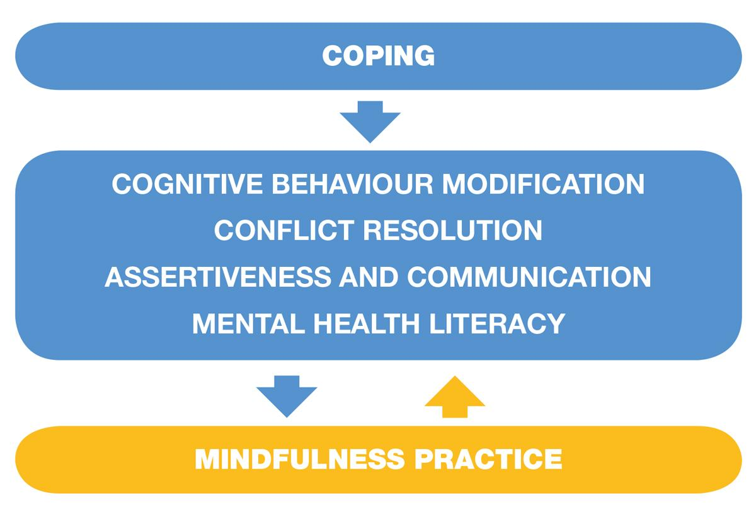

Slide 5
This competence is useful, for example, when…
During life, you will always encounter difficult situations and in order to cope with these situations in the best possible way, you need to develop adequate coping strategies. This might include:
School demands and frustrations
Negative thoughts and feelings about themselves
Changes in the body
Problems with friends and/or peers at school
Unsafe living environment/neighborhood
Separation or divorce of parents
Chronic illness or severe problems in the family
Death of a loved one
Moving or changing schools
Taking on too many activities or having too high expectations
Family financial problems

Slide 6
Theory of the skill:
Cognitive behavioural modification means
To understand our own thoughts and feelings – and how they affect each other and how they affect our behaviour.
To change inexpedient thoughts and self-talk to be more constructive
In order to be able to change thoughts and actions

Slide 7
Theory of the skill:
Conflict resolution means
To understand how to solve conflicts as win-win situations for both parties.
To learn problem-solving skills and to communicate clearly.
To learn how to negotiate.
In order to be able to solve conflict constructively

Slide 8
Theory of the skill:
Assertiveness and communication strategies means
To promote empathy.
To express thoughts and needs in a social acceptable way.
To listen actively.
In order to be able to communicate in an honest and appropriate way

Slide 9
Theory of the skill:
Mental health literacy means
To be able to recognize mental health issues such as anxiety and depression.
To learn about the causes of these issues.
To learn about your own possibilities to influence mental health issues.
To learn about possibilities for professional help.
In order to be able to help yourself and others in case of need.

Slide 10
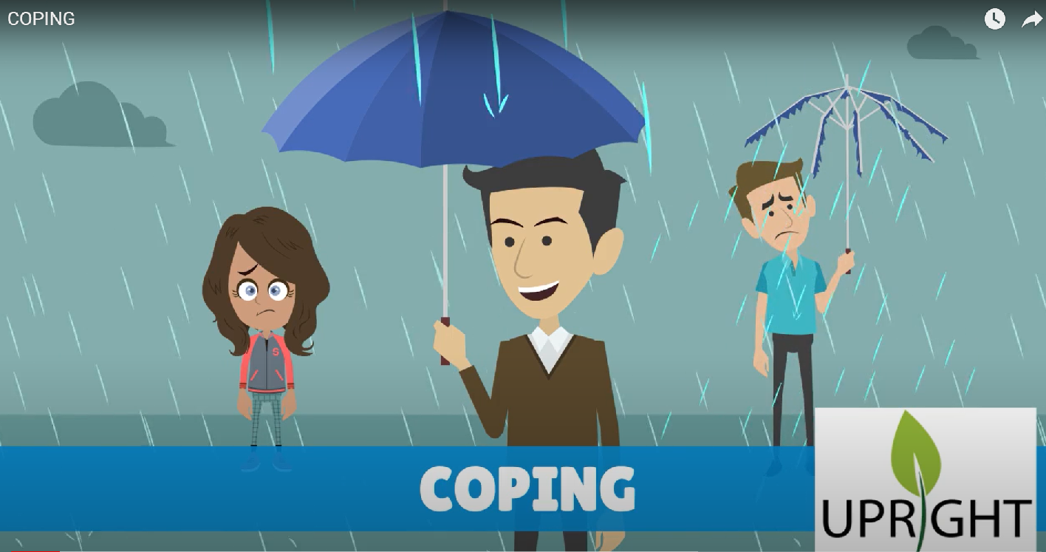
UPRIGHT video: Coping
https://www.youtube.com/watch?v=NOnFMUoB9m4

Slide 11
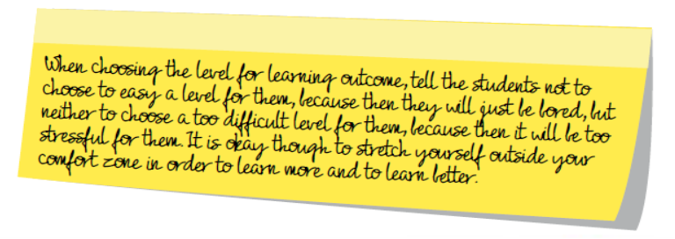

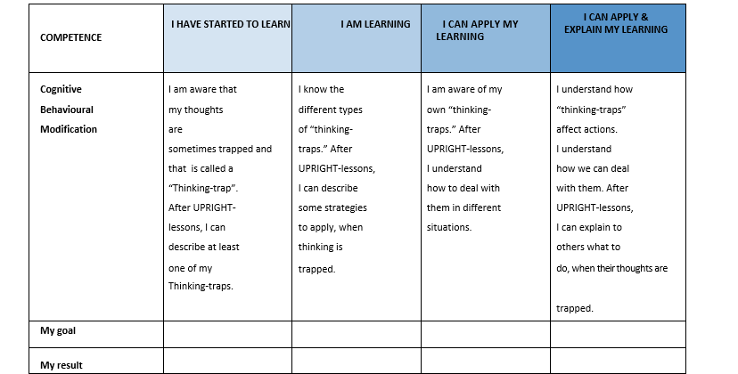
Rubric for Coping

Slide 12

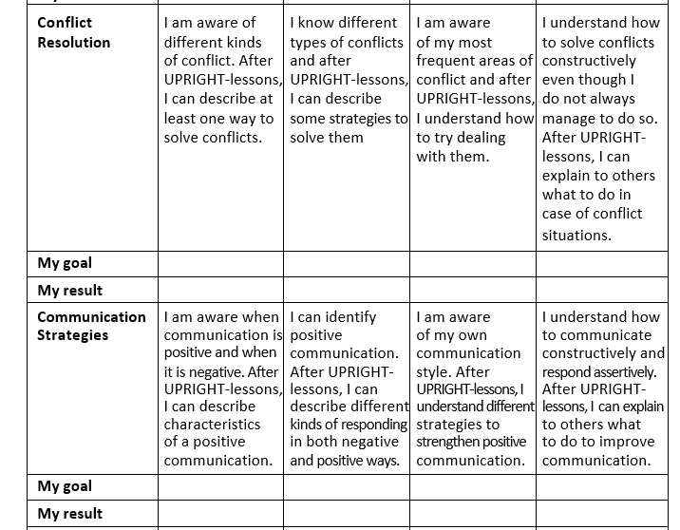
Rubric for Coping

Slide 13
Rubric for Coping

Slide 14









Thank you!
This presentation is part of a project that has received funding from the European Union’s Horizon 2020 research and innovation programme under grant agreement No 754919. The information reflects only the authors’ view and the European Commission is not responsible for any use that may be made of the information it contains.

