Slide 1
Assertiveness & Communication Strategies

Slide 2

UPRIGHT Overview

Slide 3
Food for thoughts
What do you know about communication?
What does good communication consist of?
Have you ever failed to communicate with someone? If so, why or why not?

Slide 4
Definition
Assertiveness and communication strategy means:
To communicate in a clear, precise and meaningful way and to listen actively to others

Slide 5
This skill is useful, for example, when…
“When you disagree with someone, and you do not want to lose your temper”
“When you want to communicate with others the way you want them to communicate with you”
“When you need to listen to another person (for example, parents, or teachers) and be nice”.

Slide 6
Theory of the skill:
To communicate assertively means
Saying what you think and feel without demeaning or hurting others.
Communicating in an open-minded, honest and direct manner.
Basing the communication on yourself; using “I” instead of “you”, thus avoiding direct confrontation.
Consistency in speech, body language and tone.
Respecting others and still being able to set your own limits.

Slide 7
Theory of the skill: Communication styles
Passive | Aggressive | Passive-aggressive | Assertive
You avoid expressing opinions and feelings | You express and advocate your own feelings and opinions, violating the rights of others | You are passive on the surface but expressing your anger in a subtle way | You clearly state your opinions and feelings and firmly advocate your rights and needs without violating the rights of others
You say too little too late | You say too much too quickly | You say nothing but think differently | You say the right thing at the right time
Feelings: You have feelings of fear, anxiety, guilt, fatigue or nervousness | Feelings: You have feelings of anger, rage, hate or hostility | Feelings: You avoid showing your true feelings | Feelings: You have feelings related to the situation and act upon them constructively
Verbal expression: Oh, it does not mean a thing If you don’t mind Sorry | Verbal expression: Oh, you had better take care because…. What delusions do you have? Ridiculous Foolish | Verbal expression: Oh, I don’t mind (but I do) It’s okay (but it is not) Don’t think of me (do) | Verbal expression: I think… I feel… I wish… What do you mean?
Body language You twist your hands. You bend your head. Your eyes are unfocused. Your voice is hesitant, insecure. | Body language You point with your fingers. You lean forward. You stare. You raise your voice. | Body language You mutter to yourself instead of confronting the issue. You use facial expressions that do not match your feelings. You use irony and sarcasm. | Body language You have a natural body posture. Your movements are relaxed. You maintain good eye contact. You use a strong, calm voice.

Slide 8
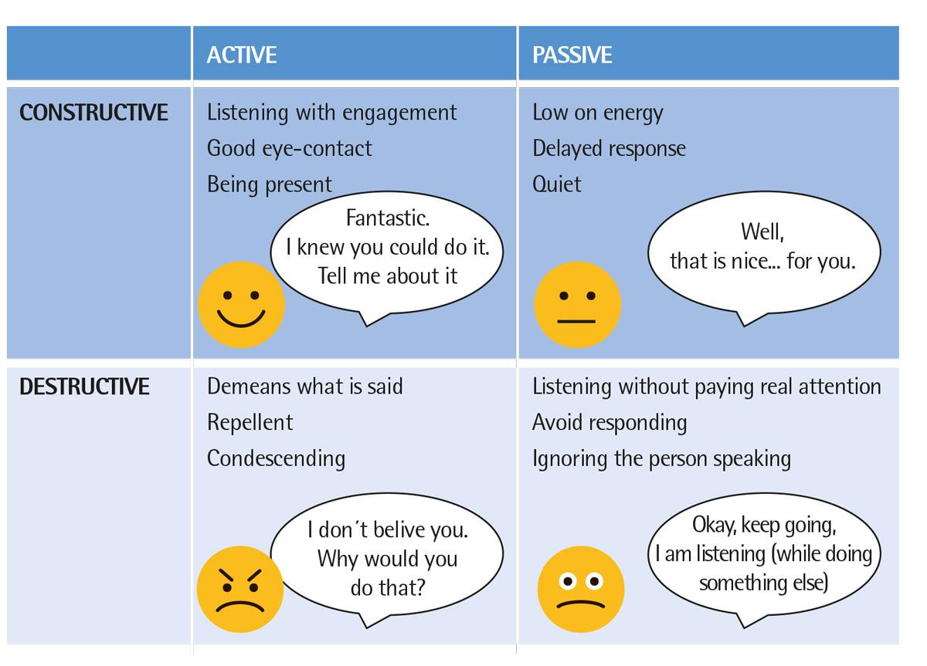
Theory of the skill: Active constructive responding

Slide 9
UPRIGHT video: Assertiveness & Communication Strategies
https://youtu.be/82QKek-3BkY

Slide 10

A story for discussion: Bucket and dipper
Everyone can contribute to positive emotions and positive communication in class and in the entire school.
Imagine that we all have an invisible bucket. When your bucket is full, you feel happy, connected and full of energy. When your bucket is empty, you feel poorly and exhausted.
Imagine also that we all have an invisible dipper, which we can use to refill or empty the buckets of others. What fills a bucket is positive communication such as positive comments, active listening, paying attention, strength spotting. What takes away from the contents of buckets is negative communication such as bad comments, negative criticism and lack of attention.
When you fill the buckets, you and others find out how to communicate to create good days, good experiences and good relations.

Slide 11
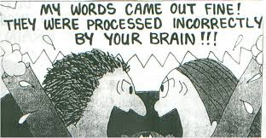
Dilemma for discussion

Slide 12
Exercise: Types of response
Form groups of 4 students – if possible
There must be at least one person to represent each of the four types of response. If there are fewer than four persons in a group, one of you may represent more than one type. If you are more than four persons in a group, you will just need to represent the same type of response.
  Choose someone to represent active-constructive response.
  Choose someone to represent active-destructive response.
  Choose someone to represent passive-constructive response.
  Choose someone to represent passive-destructive response.
Invent three cases or be inspired by the following examples. The participants must give a response that they feel would be the right one for the type they represent. Take one case at a time and let all the representatives suggest an answer according to type.
  Case 1: A friend says, “I broke my record yesterday.”
  Case 2: A classmate says, “I don’t understand the assignment.”
  Case 3: A parent says, “You have to do your homework.”

Slide 13
Exercise: A pocket full of beads
Fill your right-hand pocket with beads at the beginning of the day/lesson.
Every time you feel that you have contributed to positive communication, move a bead into your left-hand pocket.
At the end of the day, check how many times you have succeeded in supplying a positive communication input.

Slide 14
Exercise: Active listening
Pair up with a partner.
In the first part of the exercise, you tell your partner about your last holiday. Your partner uses as many techniques for active listening as possible: smiling, nodding, humming, eye contact, etc.
Next, you tell your partner what you did last weekend. Your partner should try to avoid listening actively by avoiding eye contact, fiddling with something, turning his head away, being a bit restless, etc.
Then, you swap places and let your partner tell you some stories while you listen first very actively and then very passively.
Discuss how this made you feel.

Slide 15
Exercise: Bad Habits
Below is the list of ten bad habits in listening.
Find a bad listening behaviour of which you might be guilty when communicating with others. Be honest with yourself!
  I interrupt often or try to finish the sentences of others …
  I jump to conclusions …
  I am often too paternalistic and answer with advice, even when not requested …
  I make up my mind before I have all the information …
  I do not give any response …
  I am impatient …
  I lose my temper when I hear opinions with which I do not agree …
  I try to change the subject to something that relates to my own experiences …
  While the other person is speaking, I think more about my reply than of what he or she is saying …

Slide 16
Exercise: Real Life Ratio
Listen to a conversation, news item or a movie episode of your own choice (no longer than 5 minutes) and record all the positive and negative words below:
Now, calculate the happiness ratio by dividing the number of positive words by the number of negative words. So, for example, if you have 10 positive words and 5 negative words, your happiness ratio will be 2:1
Positive words | Negative words

Slide 17
Mindfulness: Shake it up – calm it down (1)
Stand up, with your chair behind you. Be careful not to be too close to the next person. Create your own bubble, giving you and the people around you sufficient space. Just look straight ahead and follow my guidance. Start by shaking your left hand 8 times, your right hand 8 times, your left foot 8 times and your right foot 8 times. Then shake your left hand 4 times, your right hand 4 times, your left foot 4 times and the right foot 4 times. Now shake twice your left hand, your right hand, your left and right foot. Repeat the same exercise, once for each hand and foot, then jump and clap your hands.
Sit down slowly and mindfully. Notice, to the best of your ability, how your body moves as you sit down, remaining in your own bubble; just be aware of yourself and your body.
While you are you sitting, pay attention to your feet flat on the floor, your legs uncrossed and your spine straight. Imagine that you are sitting majestically like a mountain. The posture is strong but comfortable. Your intention is to be awake and aware. You can lower your gaze or allow your eyes to close if that feels comfortable.

Slide 18
Mindfulness: Shake it up – calm it down (2)
Imagine that your attention is like a flashlight that you will use to examine your body and look at what you find there, with curiosity and kindness. You can start with moving the flashlight of attention to your feet. Then, include your feet and ankles. Are there any sensations that you notice there: the touch of your socks, heat or cold, or maybe nothing? If there are no sensations and you simply register a blank, this is just fine. You are not trying to make anything up or change anything; you are just paying attention to what is already there. Now, expand your attention to the lower legs… and then the knees… and the thighs. Thus, you are ”holding onto” both your legs now, centring your awareness. Now, expand your attention again, up to the hips, the lower back and the lower abdomen. Then, gradually broadening your attention, move up the torso to your chest and the back, right up to your shoulders. Do you notice any physical sensation here?
Now, expand again to include your arms, your neck, face and your head until you are aware of your whole body. See if it is possible to allow the sensations in your body to remain just as they are, not trying to control or change anything. Just sit. Now, bring your awareness to the centre of the body, to the sensation of breathing. Notice that your breath moves in and out of the body. If you like, you can place your hand there for a few breaths and feel the abdomen rising and falling. Just breathe in and out. Do not try to control your breathing at all. When you notice that your mind wanders away from the breathing to thinking, planning, remembering or daydreaming, do not criticise yourself, simply notice where it goes and then gently bring back your attention to breathing. This is the only thing that you need to do: pay attention to your breathing.
Just come back to breathing whenever your mind wanders. Remember that breathing is always there, an anchor where you can attach your attention and bring you back to the present. It is always there, deep within you, a place of stillness and peace. Now, slowly emerge from the exercise and notice the people around you.

Slide 19
Transfer exercise
Key Learning Points
1) What have you learned from this chapter on assertiveness and communication strategies?
2) What exercises did you find helpful and relevant to you?
3) How can you use what you have learned here in other situations or settings?
Use the app ExplainEverything and explain what you have learned from the lesson on assertiveness and communication strategies
or
Write it down in your notebook.

Slide 20









Thank you!
This presentation is part of a project that has received funding from the European Union’s Horizon 2020 research and innovation programme under grant agreement No 754919. The information reflects only the authors’ view and the European Commission is not responsible for any use that may be made of the information it contains.

