Slide 1
Leadership

Slide 2
UPRIGHT Overview

Slide 3
Food for thoughts
What do you know about leadership skills?
How can leadership skills be applied to everyday lives?
Could you describe the characteristics or qualities of a good leader?
Could you describe a situation in which you acted as a leader?

Slide 4
Definition
Leadership means
To be influencing and helping others, directing and motivating their actions toward collective achievements

Slide 5
This skill is useful, for example, when…
“When you are named the class/school president.”
“When you are taking care of younger siblings at home.”
“When you’re doing a group’s project and see that it is going bad; you decide to take the lead and make it go well and fix it.”

Slide 6
Theory of the skill: Leadership
Leadership as a practice includes:
A) Defining, establishing, identifying or translating a direction for a collective action.
B)Facilitating or enabling the collective processes.
Anyone can improve their learnt leadership skills because they involve behavioural activities - skills that can be taught and not just innate attributes.

Slide 7
Theory of the skill: A leader should
Convince the group members to do what they should do.
Help and influence others positively by directing and motivating their actions.
Create and preserve good relationships and morale in the group.

Slide 8
UPRIGHT Video: Leadership
https://youtu.be/CthgcxSO00s

Slide 9
A story for discussion
John is a twelve-year-old boy who arrived in a new city with his parents. John was enrolled in the only community school in the city. The community school had dwindled to a small number of students; many children stayed out of the school because it did not have good facilities. The school building was very old, in need of repair and modernisation, and the seats in the classrooms were broken. John made friends with Anna, George and Sarah who were all in the same grade as John. John was fond of browsing the Internet and read about a “GoFundMe” campaign that raised funds to support the victims of a tsunami. He shared the idea of raising funds with his friends and they set up a website to collect money to renovate their classroom. Soon, the friends formed a group called “YouthUp” to popularise their fundraising on social media networks. In a few months, they raised so much money that they not only renovated their classroom, but also several other classrooms and buildings in the community school. This changed the look of the school and demonstrated a new sense of school community and inclusion. The YouthUp group became famous all over the city and organised extra-curricular activities with other students, with support from the teachers and staff. The community school improved all its indicators, the attendance increased, student performance improved and the number of students increased. The school acquired a new morale and climate. New students enrolled on the word of their friends who were already in the school. YouthUp soon signed on many students who helped to promote youth empowerment and achievement in the school and throughout the community. Perhaps the most important leadership quality of John was that he insisted that the new spirit and climate at his school was not to be attributed solely to his efforts but to the contribution, spirit and vitality of the YouthUp group and everyone else in the school. John is an example of leadership as a positive human quality.

Slide 10
Dilemma for discussion
Divide the class into two teams.
One team is supporting John to take the full credit for the success caused by his leadership
The other team is supporting John to share the credit with everyone in YouthUp group.
Each team has 3 minutes to work on the arguments to support their point of view.
When you are ready, you have five minutes to debate whether John should have taken the whole credit for the changes in the community school brought about by successful fundraising. Or was John right to share the credit with everyone in YouthUp’ for contributing to the change?

Slide 11
Exercise: Implementation of John’s story
Form groups of 4–6 students
Each group reads the story about John and provides responses for the Leadership Skill Record Sheet A together.
Each group nominates one person to present their responses. Remember that there are no wrong or right answers.
After the presentations, you can transfer the Leadership Skill Record Sheet of the group to your own sheets to take them home.

Slide 12
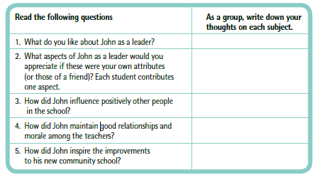
Exercise: Implementation of John’s story
Leadership Skill Record Sheet A

Slide 13
Exercise: Your leadership skills
Reflect upon your own leadership skills.
Use your reflections to fill the Leadership Skill Record Sheet B.

Slide 14
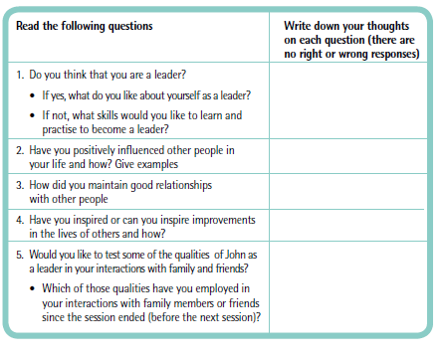
Exercise: Your leadership skills
Leadership Skill Record Sheet B

Slide 15
Exercise: The Amazing Spiderman show
Choose a student among you to be the leader in the exercise.
The leader has to select students who will attend the Amazing Spiderman show. Only five students are admitted at a time, but there are more than five students in the class.
How is s/he going to manage the selection process so everyone can see the show? Note how s/he
  Communicates the decision to time the selections, one group after another.
  Ensures that good relations are maintained.
  Convinces others to wait patiently for their turn.

Slide 16
Exercise: Simon says
Choose a student as your leader. He or she stands in front of the class and says:
“Simon says, ‘you shall jump up and down’”.
The leader chooses different activities for the class. However, they only have to do it if the leader remembers to say, “Simon says”, at the beginning of each sentence. Try using different speeds.
If the leader does not say, “Simon says”, you do not follow the orders.
If you obey an order without the phrase, Simon says at first, you have to leave the game.
When 10 students are out of the game, you choose a new leader and start over again.

Slide 17
Exercise: Vision, mission and planning
Leaders must have a vision to persuade others to follow them.
Form groups of 4–5 students.
Imagine that you are the new team of school leaders at your school.
Brainstorm on your ideas for a:
  Vision: The ability to think about or plan the future with imagination and wisdom.
  Mission: Any important task or duty that is assigned, allotted, or self-imposed.
  Planning: Deciding on the actions necessary to achieve a desired goal.
Make a poster showing your vision and mission statements and the ways to put them in practice.

Slide 18
Mindfulness: Body scan
In this exercise, you sit in your chair but at home, you can also choose to lie down. You are going to pay close attention to your body. You could try to imagine that your attention is like a torch, which you point at your body and scan it firmly but with attitude of kindness and curiosity. In this practise, we are not trying to get anywhere or strive to achieve anything special. The intention is simply to give some time to each region of your body to see what is already here. I invite you to imagine that you all are in your own bubble; you don´t pay attention to the people around you, just give yourself and others some space. You can close your eyes or you can just let them rest on something in front of you.
Sit comfortably, with your feet on the floor, hands in your lap or on the table, your head balanced and your back straight but not too tight. Make your body rest like a majestic mountain. Start by bringing your attention to the sensations of your breathing. Feel your breathing right now; you don´t need to change it, just sense it as it is. Follow few breaths as best you can. Just breathe in and breathe out.
Now bring your awareness to your body and move the torchlight of attention to your feet, both left and right. Are there any sensations that you notice there? Can you feel the bottoms of your feet? Can you feel your toes? Your heels? Do you sense the touch of the socks? Do you notice any other sensations? Warmth, coolness, tingling or tightness? If do not notice anything, that is also fine, you are not making anything up, just sensing things as they are.
Now move your torchlight of attention to your ankles, to your legs, calves, shins and knees. Do not think about your knees but sense what is there if you can (if anything at all). Then, move your attention to the thighs and all the way up to the hips. Can you feel how your chair is supporting you, resting there like a majestic mountain? Can you sense your back, starting with the lower back and all the way up to your shoulders? Just notice how your back feels. Now, move your torchlight to the belly; can you notice how your belly moves with your breathing? Can you hold your attention there for a moment? If you notice that your mind wanders away, don´t worry, that is just how minds work. The only thing that you need to do is to move your attention kindly back where you want it to be, i.e. the belly for the time being. Now bring your awareness to your shoulders. How are your shoulders? Then move from the shoulders to your fingers, wrist, arms and back to the shoulders again. Up to your neck and to your face. Then, to your chin, your cheeks, your eyes, your forehead and to your ears. Broaden your awareness to your head as a whole, as it rests there. On next inhalation, see if you can imagine that your breath flows all the way down to the toes and back, as if your whole body were breathing. Bring your torchlight of attention to your breathing as best you can. And now, just allow yourself to sit there, let yourself be just as you are. Complete and whole. Resting in awareness, moment by moment.

Slide 19
Transfer exercise
Key learning points
What have you learned from this chapter on leadership?
Which exercises did you find good and relevant to you?
How can you use what you have learned here in other situations or settings?
Use the app ExplainEverything to show what you have learned from this chapter on leadership
or
write it down in your notebook.

Slide 20









Thank you!
This presentation is part of a project that has received funding from the European Union’s Horizon 2020 research and innovation programme under grant agreement No 754919. The information reflects only the authors’ view and the European Commission is not responsible for any use that may be made of the information it contains.

